Slide 1
Fuantum Moods
Fuantum Inspirational Presentaiton

Slide 2
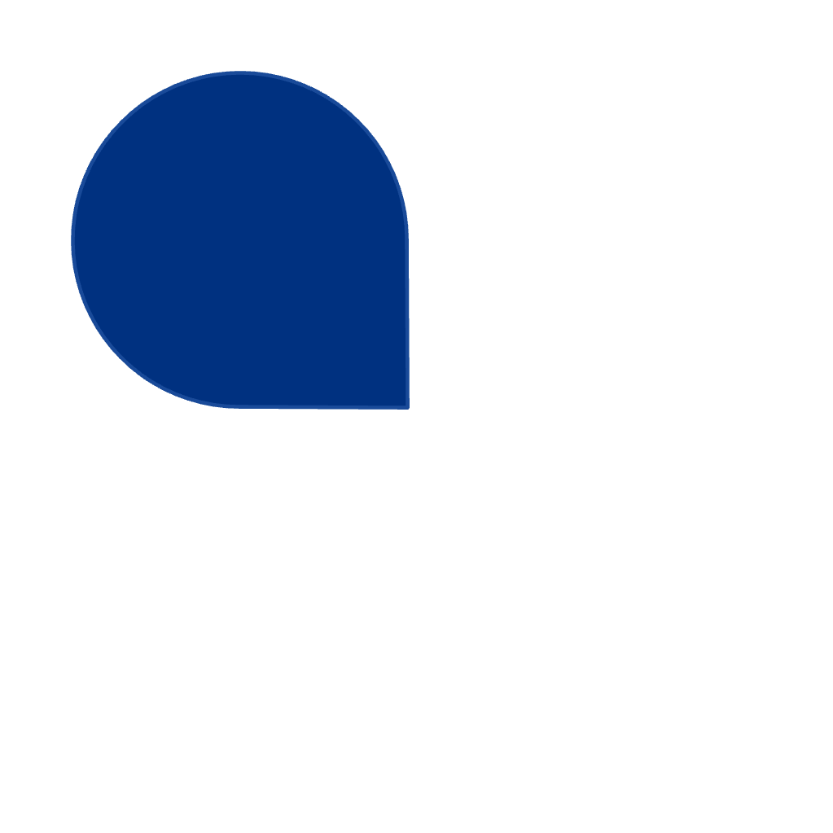
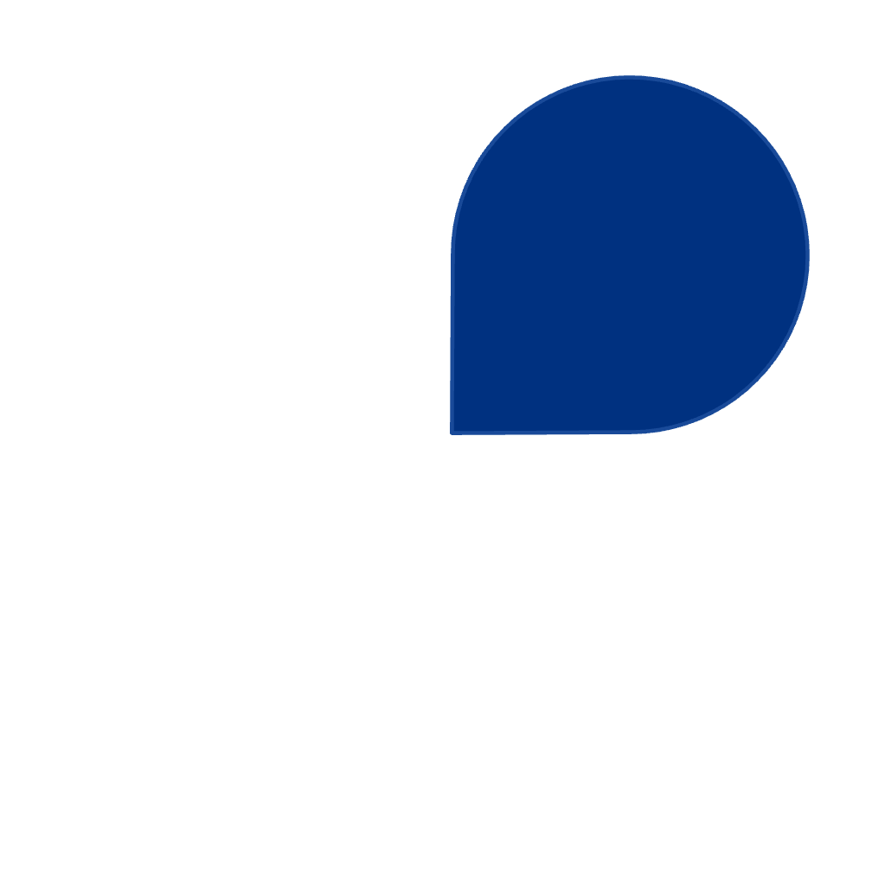
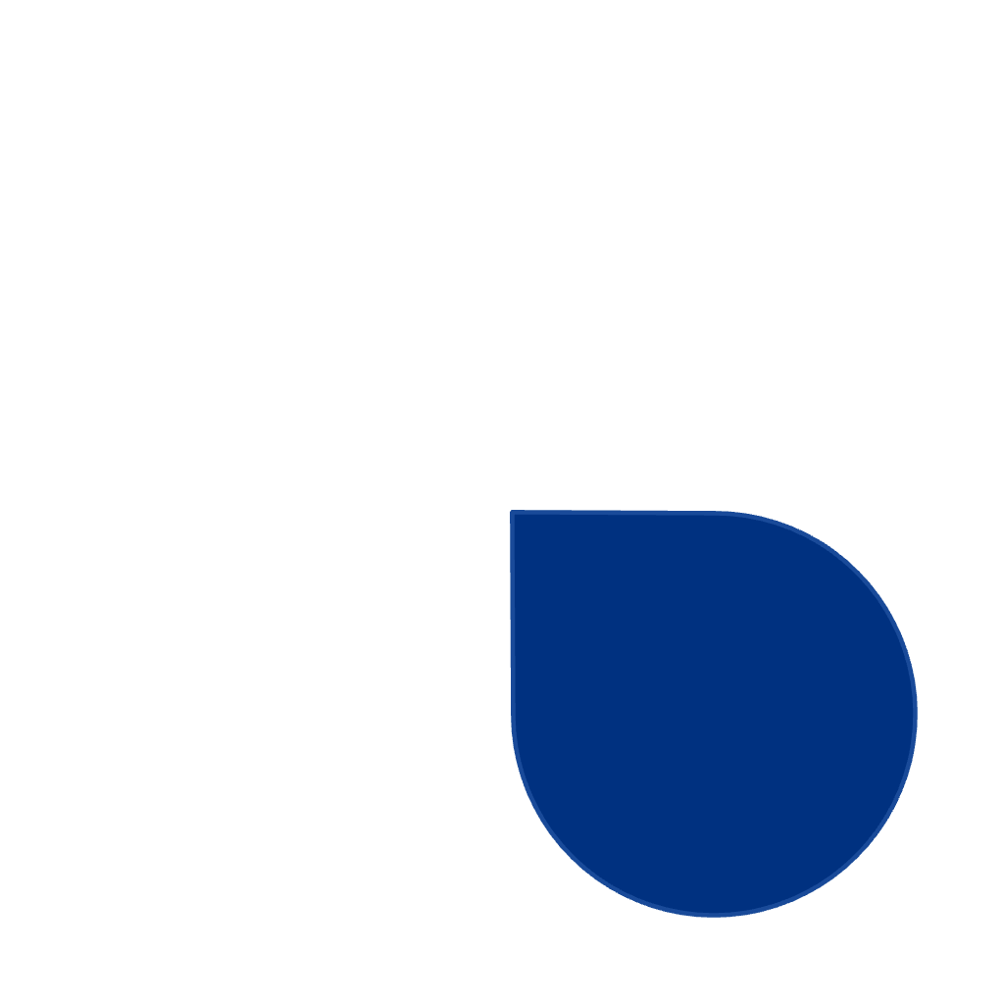
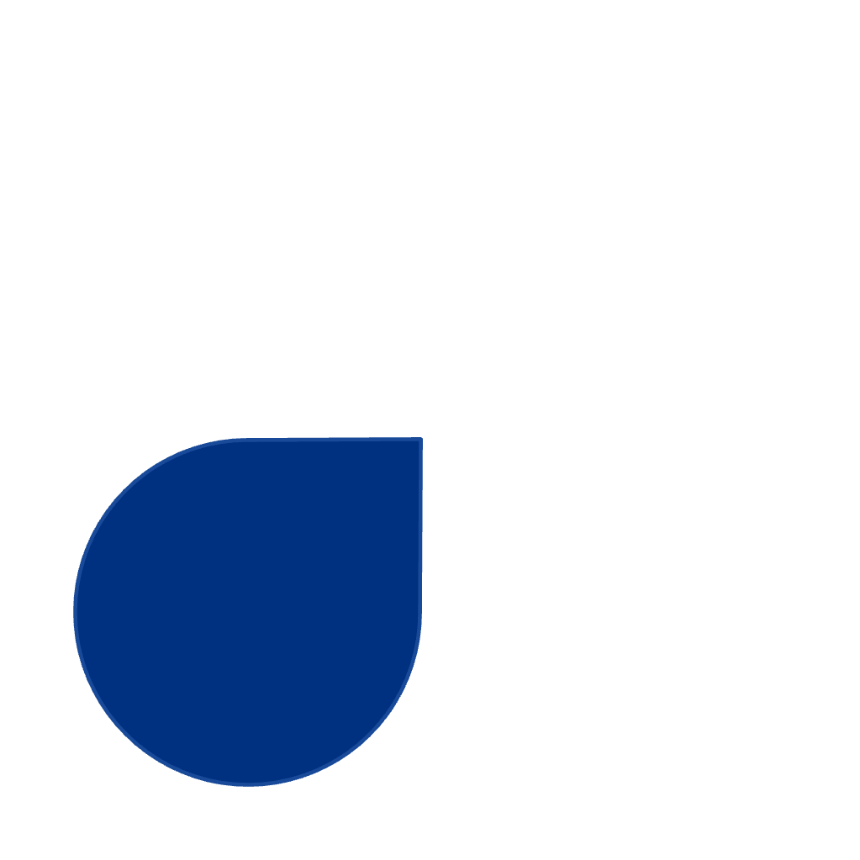
What is a Mood Board?
A mood board is a carefully curated visual collage that captures the essence of ideas, themes, and emotions you want to convey in a project. Think of it as a creative bridge between imagination and execution—a tangible representation of abstract concepts that helps crystallize your vision.
Key Benefits
Captures intangible ideas visually
Aligns teams and stakeholders
1
2
Accelerates decision-making
4
3
Prevents costly missteps
These powerful visual tools serve as the foundation for creative projects across industries. Designers use them to establish aesthetic direction, marketers leverage them to define brand personality, architects employ them to communicate spatial concepts, and creatives of all kinds rely on them to align vision and inspire action.

Slide 3


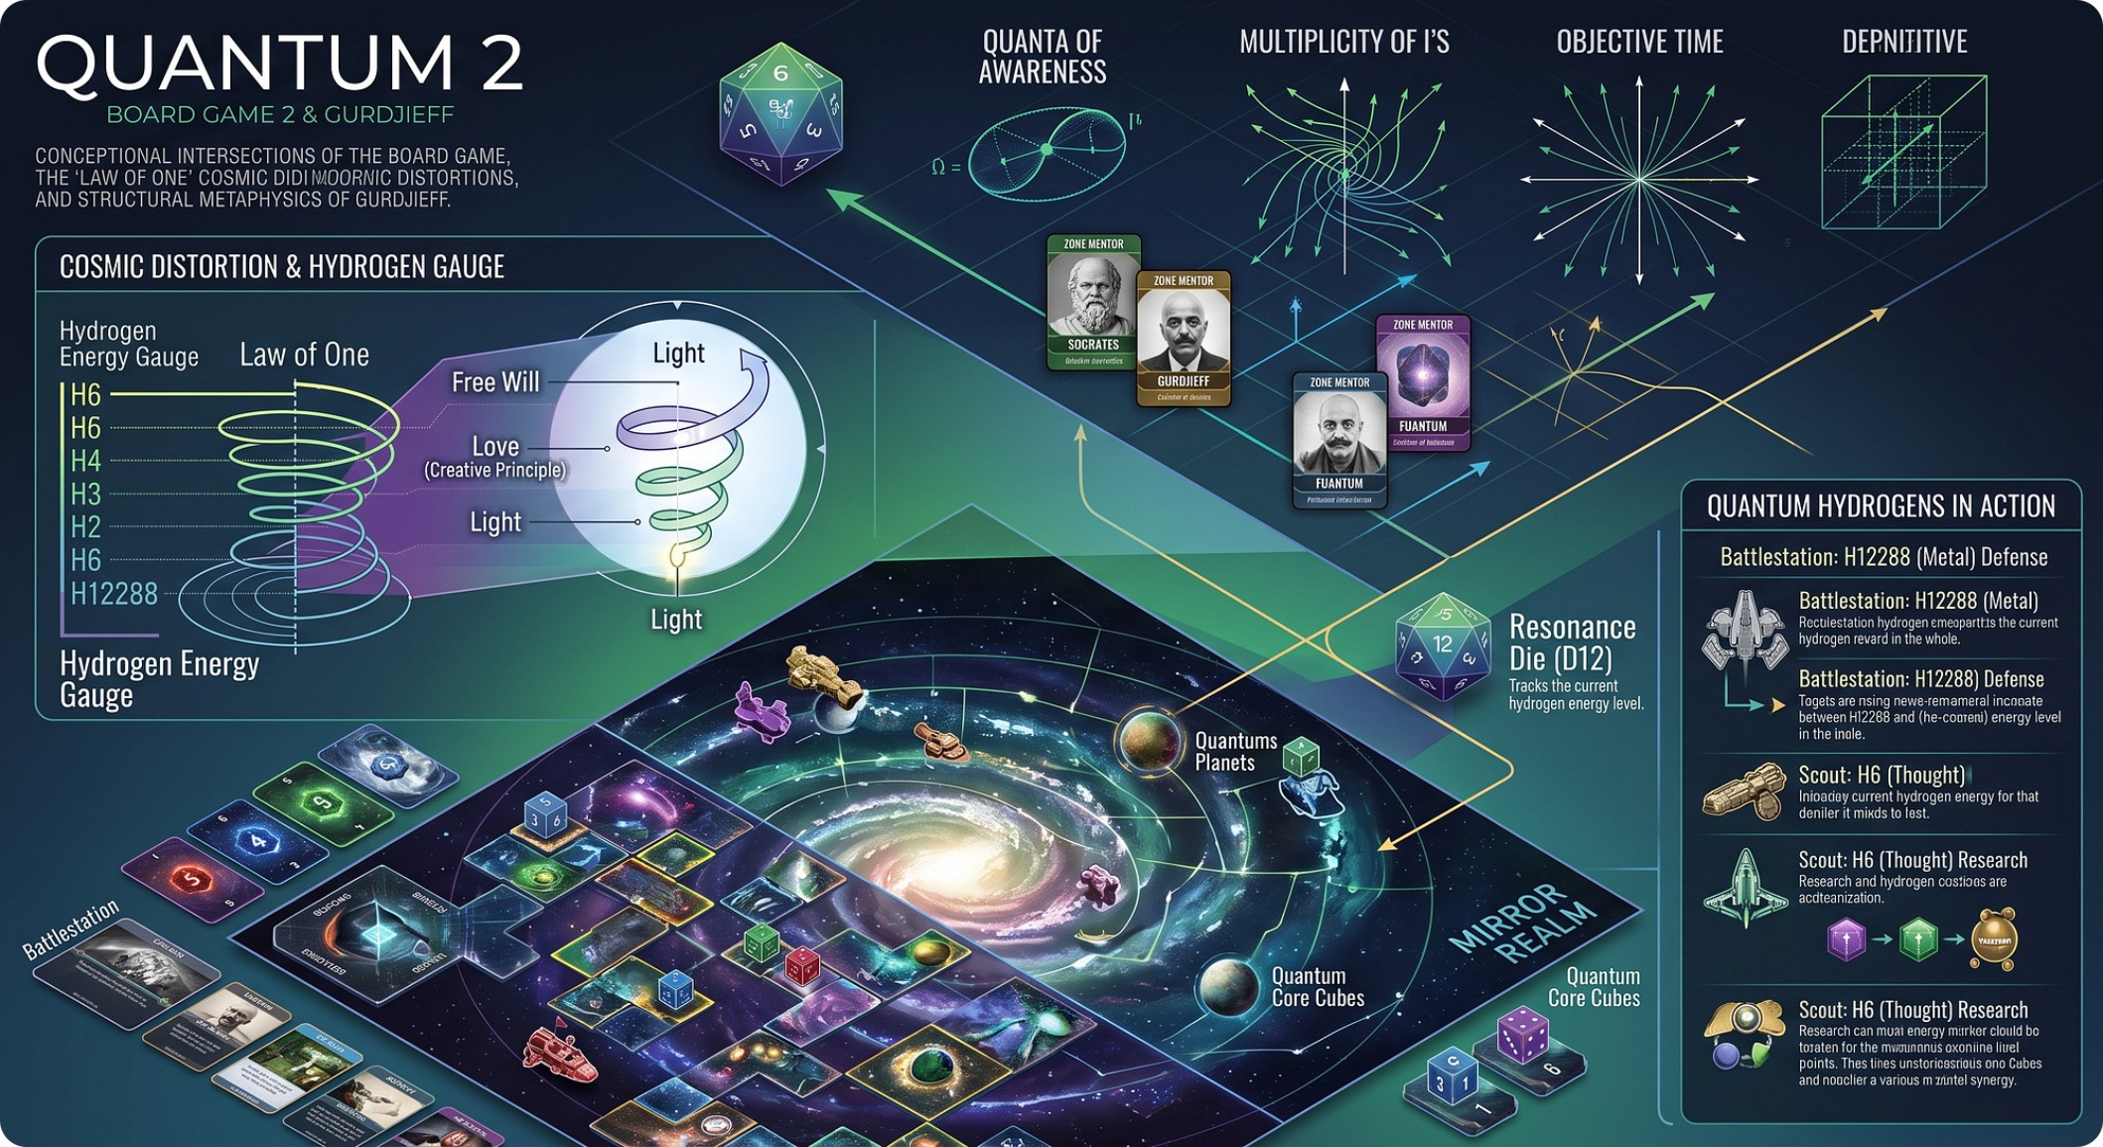
Why Use a Mood Board?
Transforms Abstract Ideas
Sparks Creative Innovation
Mood boards bridge the gap between imagination and reality, converting vague concepts and emotional intentions into concrete visual references that everyone can understand and respond to.
By collecting diverse visual elements in one place, mood boards reveal unexpected connections and inspire fresh approaches. They guide design decisions while leaving room for creative exploration.

Slide 5
THE COMPLETE PROCESS
Assembling Your Mood Board
Creating your mood board is where curation meets composition. The way you arrange visual elements matters as much as the elements themselves.
🏛 Foundation
⚙ Execution
Choose Your Canvas
Establish Visual Hierarchy
Select a platform that offers flexibility and shareability. Google Slides and PowerPoint work beautifully for presentation-style boards, while design tools like Figma offer more creative freedom for layering and arrangement.
Balance large focal images that capture attention with smaller supporting visuals that add detail and depth. Your hero images should communicate the primary aesthetic direction immediately.
01 — Compose
02 — Refine
03 — Integrate
Experiment with Composition
Play with layering, spacing, and arrangement. Try asymmetrical layouts for dynamic energy or grid structures for clean organization. White space is your friend—don't overcrowd the board.
Refine and Perfect
Step back and evaluate the overall impression. Does it communicate your vision clearly? Remove anything that doesn't strengthen the narrative. The final board should feel cohesive and intentional.
Synthesize and Share
Bring all elements into a unified whole. Export and share your mood board with collaborators or clients, inviting feedback that sharpens the vision before moving into production.

Slide 6
Key Components of a Mood Board
Color Palettes
Textures & Materials
Colors set the emotional tone of your project. From bold and energetic to soft and serene, your palette establishes the mood before a single element is designed.
Physical and visual textures add depth and tactile quality. Think rough concrete, smooth marble, weathered wood, or soft fabric—each tells a different story.
Typography Samples
Inspirational Images
Fonts express personality as powerfully as images. Serif fonts convey tradition and elegance, while sans-serifs feel modern and clean. Your type choices matter.
Curated photographs, illustrations, and patterns form the visual heart of your mood board. They communicate style, atmosphere, and the overall aesthetic direction.

Slide 7

Example: The Slack Aesthetic Mood Board
A surreal collision of 1950s Americana, cosmic conspiracy, and the sacred pursuit of Slack — where the mundane becomes transcendent and the absurd becomes doctrine
Retro-Futuristic Conspiracy
Absurdist Juxtaposition
1950s advertising imagery collides with flying saucers, mysterious symbols, and paranoid optimism — a world where every smiling housewife suspects the neighbors are from another dimension.
High art meets low culture, sacred meets profane, sincere meets ironic. Bob Dobbs grins knowingly from the pipe smoke as the cosmos shrugs and hands you a coupon.
Visual Language
Color & Texture
Conceptual Direction
Vintage halftone portraits, pipe-smoking icons, geometric patterns, and unexplained phenomena form a visual grammar that is simultaneously earnest and unhinged. Every symbol contains a hidden message. Or doesn't. Both are equally valid.
Faded Technicolor bleeds into grainy newsprint. Metallic accents wink at weathered paper suggesting hidden truths. The palette is optimistic and slightly threatening — like a cheerful government pamphlet about radiation safety.
Every component celebrates the beautiful contradiction between control and chaos, conformity and rebellion, the mundane and the transcendent. Slack is not laziness — it is the deliberate refusal to be entirely serious about anything, including Slack itself.
The SubGenius knows: You will pay to know what you really think. The mood board is the message. The message is a distraction. Praise "Bob."

Slide 8

Fuantum's Eight-Year Metamorphosis
From Heretic to Yeti — a genuine spiritual odyssey through doubt, dissolution, and the hairy wisdom of enlightened confusion (2018–2026)
The Dissolution Phase (2018–2022)
The Integration Phase (2023–2026)
Questioning dogma, shedding certainty, and learning to embrace paradox as a spiritual practice rather than a crisis of faith.
Synthesizing traditions, transcending categories, and becoming something entirely new — something with very large feet and an excellent relationship with forests.
2018–2019
2022–2023
Christian Heretic
Challenging orthodoxy from the inside. Seeking truth beyond doctrine, asking the questions the congregation politely ignored. God probably appreciated the honesty.
Hindu Synthesis
Karma, dharma, and the interconnected self. All paths lead somewhere. Some lead to the same place wearing different hats.
1
2
3
4
2020–2021
2024–2026
Buddhist Wanderer
Discovering emptiness — the good kind. Impermanence, non-attachment, and the radical comfort of having no fixed self to defend.
Subgenius Yeti
Embracing Slack. Embracing cosmic absurdity. Embracing fur. The forest is the temple. Bigfoot is the bodhisattva. Praise "Bob."
The UniBiTri Proportions reveal: One metamorphosis. Two phases. Three traditions. The Yeti does not arrive — the Yeti was always there, waiting in the theological underbrush.

Slide 9
Gathering Your Elements
Building a powerful mood board starts with knowing where to look and how to choose with intention.
Sourcing Visual Inspiration
Strategic Curation
Draw from diverse sources — internet platforms, brand assets, original photography, magazine clippings, and screenshots of designs you admire. Cast a wide net and collect more than you think you'll need.
Curating is more than collecting. Organize assets with intention, selecting only what earns its place and contributes to the mood and vision of your project.
Mix Literal & Abstract
Organize Thoughtfully
Evaluate Impact
Balance obvious references with evocative imagery that captures feeling rather than specific objects.
Sort assets by theme, color family, or project phase to maintain clarity and make refinement easier.
Every element should contribute to the overall mood — quality over quantity, always.

Slide 17
Exploring Concepts of Fuantum Thought
A sincere, playful, and occasionally absurd journey through the philosophical framework born of Fuantum's transformation — where geometry meets Slack, and paradox becomes practice.
🔱 The Heretical Foundation
🌿 The Yeti Synthesis
Certainty is the enemy of wonder. Fuantum thought begins where doctrine ends — embracing contradiction not as failure, but as the first honest step toward understanding. Paradox is not a problem to solve; it is a spiritual practice to inhabit.
Where Buddhist emptiness meets Hindu interconnection and SubGenius Slack, something strange and true emerges. The Yeti doesn't argue philosophy — it wanders freely, unbothered, fully integrated with the forest it roams. That is the synthesis.
Reality as Illusion & Slack
Consciousness & the Forest
Universal Geometry & Absurdity
The cosmos does not care about your plans. It never did. And that — once truly felt — is not nihilism but liberation. Slack is what remains when you stop fighting the indifferent beauty of a universe that simply is.
Awareness doesn't emerge from scripture or certainty. It rises from the wilderness — from sitting quietly in the woods long enough for the noise of doctrine to fade and the signal of raw experience to speak. You are not separate from the forest.
Patterns exist everywhere. The golden ratio, UniBiTri Proportions, the spiral of a fern — they are real and they are beautiful. But meaning? That's optional. You may assign it, or you may simply marvel. Both are valid. Neither is required.
The UniBiTri Proportions (1:2:3) structure this very slide — one primary concept, two supporting pillars, three detailed subjects. The framework eats its own tail. That feels right.

Slide 18



Creative Applications: Boxes as Buttons, Buttons as Slack
Fuantum's journey through design — where precision meets chaos, intention meets accident, and the Yeti emerges.
UNIBITRI PROPORTIONS 1:2:3
The Heretic's Interface
The Yeti's Wisdom
Design that questions user expectations and embraces playful contradiction. Rules exist to be bent — every familiar button hides a subversive invitation to reconsider what "clicking" even means.
Interfaces that feel natural, organic, and slightly unhinged. The Yeti knows the forest path by instinct, not instruction — designing with the body, not just the mind.
Interactive Paradox
Slack in Design
Forest Logic
Buttons that do what you expect and what you don't expect — simultaneously. The Fuantum principle: two truths coexist. A click is both an action and a question.
Leaving deliberate room for user interpretation, accident, and beautiful mistakes. Slack is not failure — it is the universe's margin note, the white space where consciousness writes its own meaning.
Organic patterns that feel alive, responsive, and slightly mysterious. Like UniBiTri geometry, the forest has no straight lines — yet every branch follows a deeper mathematical truth.
To become the Yeti is to design with both precision and chaos — wielding geometry with one hand, releasing accident with the other. This is Fuantum's transformation.

Slide 19
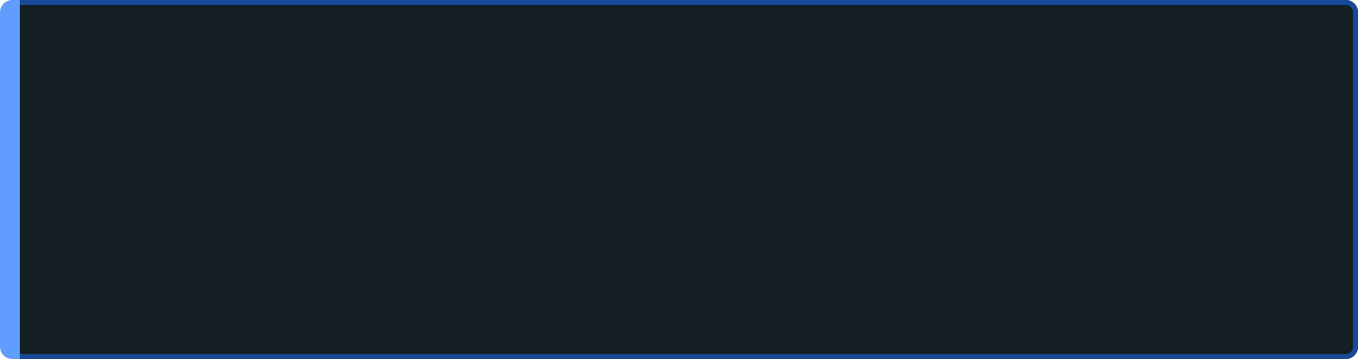

Mood Board as Spiritual Practice
Eight years of Fuantum Thought distilled into a living method — where curation becomes inquiry, and the board itself becomes the journey.
The Heretic's Approach
1
Collect Without Judgment
Curate with doubt. Question every image you're drawn to — why this and not something stranger? Contradiction is not a flaw in the board; it is the board's most honest feature. Let opposing aesthetics sit uncomfortably next to each other and resist the urge to resolve the tension.
In the early phase, the only rule is volume. Gather everything — cosmic, mundane, broken, luminous. Patterns do not announce themselves; they surface only after you have stopped trying to find them. Eight years of Fuantum practice begins here, in the uncurated pile.
2
Embrace Contradiction
The Yeti's Method
Place the ancient next to the synthetic. Allow the sacred geometry to bleed into the industrial grid. Paradox is not a problem to solve — it is the epistemological signature of Fuantum Thought itself. The board that makes perfect sense has already told a smaller truth than it could have.
Trust the pull before the logic. The forest does not explain itself — and neither should your instincts. When an image calls to you without reason, that is the signal. Accept what emerges from the undergrowth. The hand that reaches for the image knows something the mind has not yet named.
3
Trust the Unfinished
A mood board is never complete — and Slack means knowing when to stop trying to complete it. The final discipline is releasing the need for resolution. The open edge, the missing corner, the image you almost added — these absences are part of the meaning. Wisdom is knowing when the board has spoken.
The board is not a deliverable. It is a record of the questions you were brave enough to sit with.

Slide 20

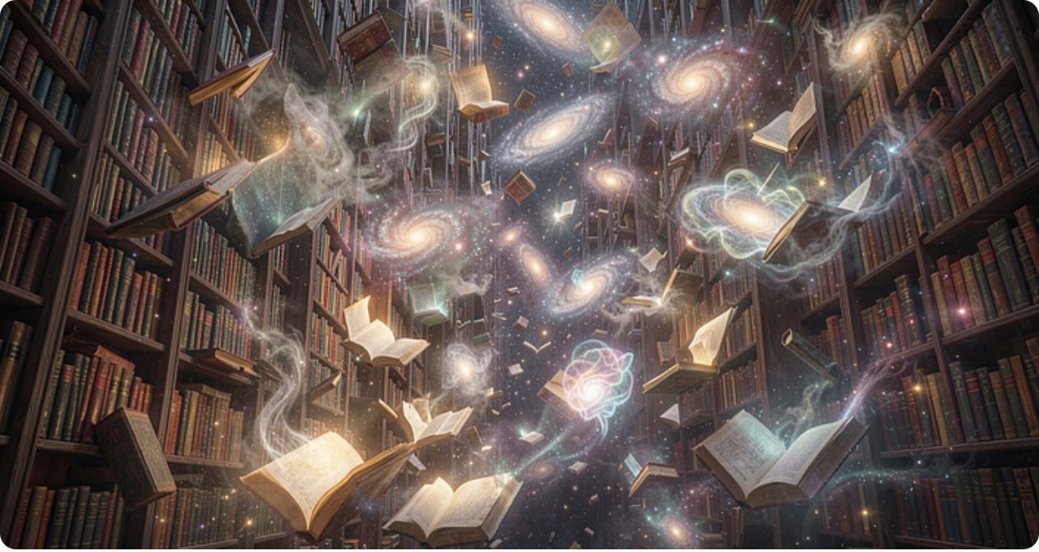
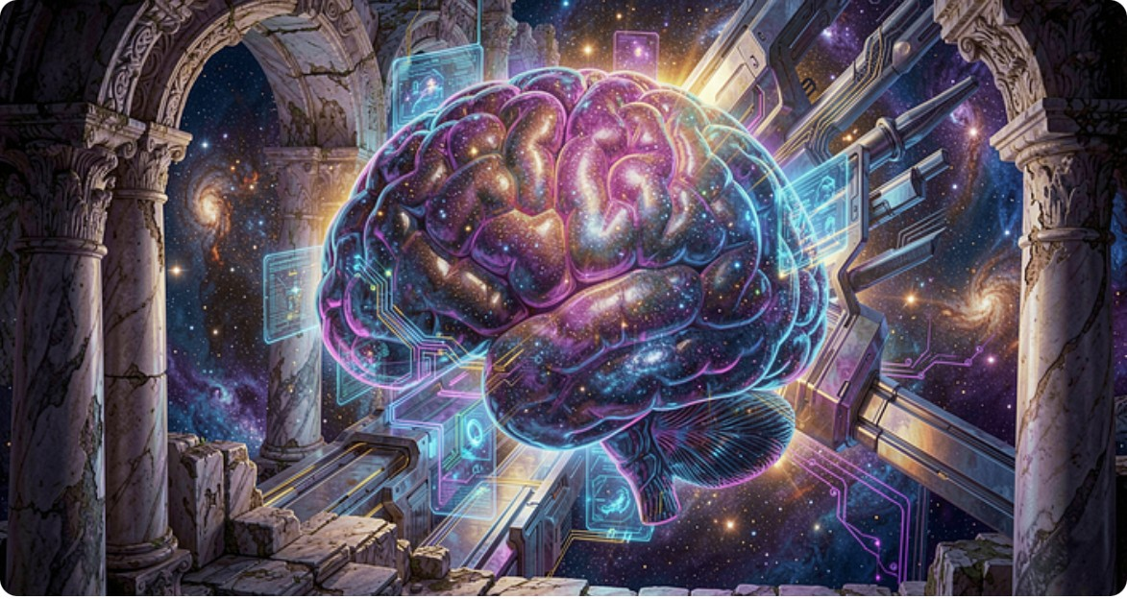
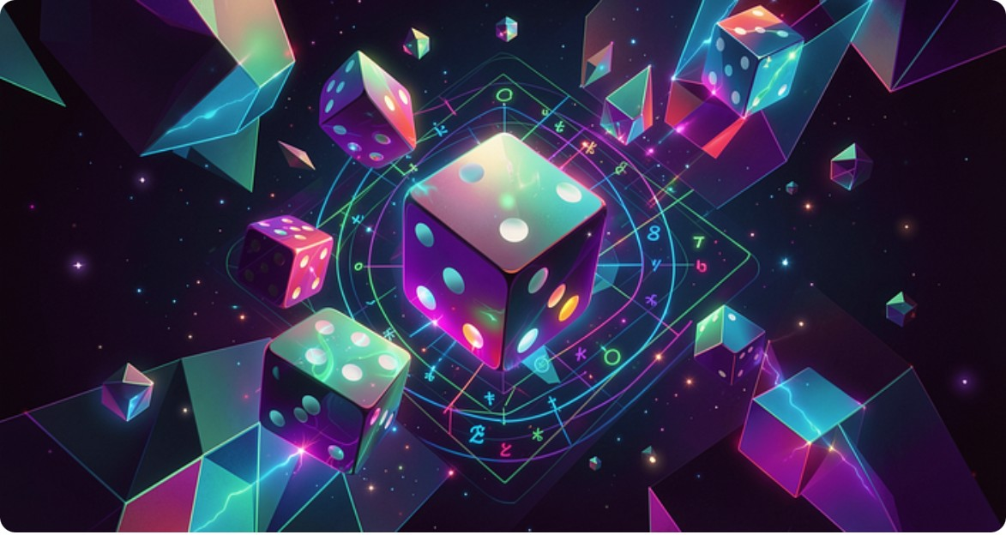
UNIBITRI PROPORTIONS — 1:2:3
The Process So Far: From Heretic to Yeti
A visual chronicle of Fuantum's transformation — deconstructing certainty, synthesizing the absurd, and arriving fully hairy.
The Dissolution
Visual Language
Philosophical Framework
Deconstructing certainty through mood boards, visual exploration, and spiritual questioning. Every assumption was a candidate for collapse.
Mood boards as spiritual cartography — images became portals, not decoration.
UniBiTri Proportions as a map of transformation: 1 origin, 2 pillars, 3 depths.
The Integration
The Yeti Emerges
Synthesizing ancient traditions into a coherent (yet gloriously absurd) philosophy of Slack and forest wisdom. The contradictions became the point.
The final form: hairy, wise, slightly confused, and entirely at peace with the forest.
Visual documentation of Fuantum's journey — each image a stage of transformation

Slide 21
Behold: The Gigonowmhead
This Fuantum presentation is a transmission from the minds of the Subgenius, signed by the venerable Clench Gigonowm himself. May your Slack be eternal, your Yeti wisdom profound, and your journey through the quantum forest ever absurd.
Praise "Bob"!

